Slide 1
Role of People, Process, and Tech In InfoSec
People, process, and technology are together referred to as the Information Security Triad
All three aspects help to form a holistic view of Information Security
All three are important and cannot be overlooked in an Information Security program or activity

Slide 2
Role of People, Process, and Tech In InfoSec
People:
People must be trained to effectively & correctly follow policies, information security processes, and implement technology
Social engineering and phishing are aspects that people must be trained to handle appropriately

Slide 3
Role of People, Process, and Tech In InfoSec
Processes are fundamental to effective information security
User access management
Backups
Incident management
Change management
Vulnerability management
Risk management

Slide 4
Role of People, Process, and Tech In InfoSec
Technology plays a central role in the Information Security program:
Firewalls
Antivirus
Email anti-spam filtering solution
Web filtering solution
Data loss prevention (DLP) solution

Slide 5
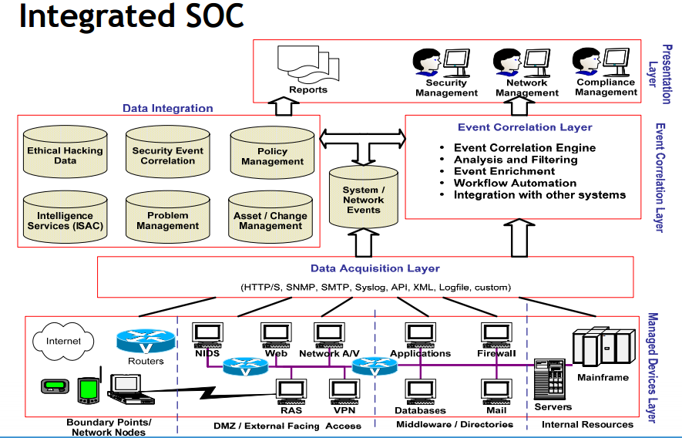
Role of People, Process, and Tech In InfoSec
https://www.rsaconference.com/writable/presentations/file_upload/tech-203.pdf

